Slide 1
Good Cabs
TRANSPORTATION ANALYSIS

Slide 2
AGENDA
Introduction
Problem Statement
Good Cabs: Unveiling Performance Insights and Emerging Trends
Data Modelling
Report Pages

Slide 3
INTRODUCTION

Slide 4
GOODCABS
Good Cabs, a rapidly growing cab service, entered the Indian market two years ago and has already made its mark by expanding to tier-2 cities.
Driven by their mission to empower local drivers, Good Cabs is committed to creating sustainable livelihoods and supporting hometown communities.
Now, as they scale further, the management is keen to evaluate their performance across critical areas: trip volumes, revenue growth, customer satisfaction, and the achievement of ambitious business targets. By focusing on these metrics, Good Cabs aims to ensure they continue delivering quality service while making a positive social impact.

Slide 5
PROBLEM STATEMENT
Provide Insights to the Chief of Operations in the Transportation
Good Cabs, a cab service company established two years ago, has gained a strong foothold in the Indian market, focusing on tier-2 cities. Unlike other cab service providers,
Good Cabs is committed to supporting local drivers and helping them make a sustainable living in their hometowns while ensuring excellent service to passengers.
With operations in ten tier-2 cities across India, Good Cabs has set ambitious performance targets in 2024 to drive growth and improve passenger satisfaction.
As part of this initiative, the Good Cabs management team aims to assess the company’s performance across key metrics, including trip volume, passenger satisfaction, repeat passenger rate, trip distribution, and the balance between new and repeat passengers.

Slide 6
GOOD CABS: UNVEILING PERFORMANCE INSIGHTS AND EMERGING TRENDS
Objective
The goal is to gain a deep insight into the company’s performance, uncover potential growth opportunities, and refine strategies to boost operational efficiency while elevating customer satisfaction.

Slide 7
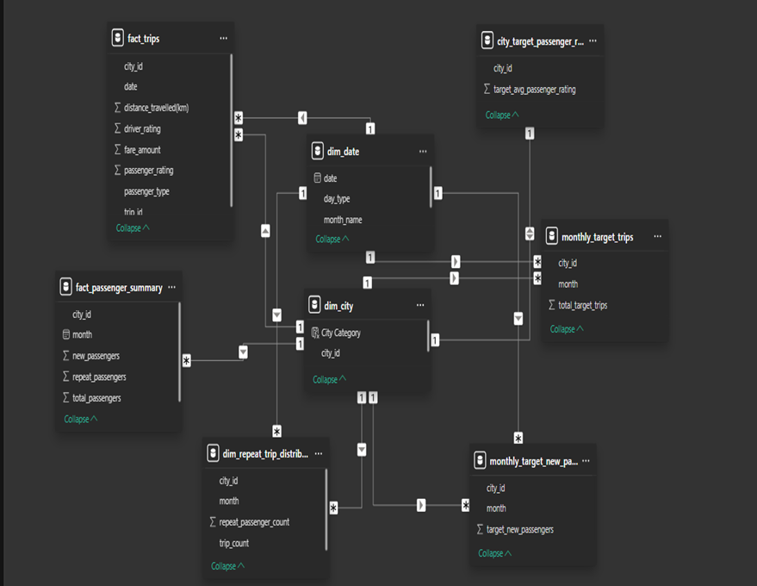
DATA MODELLING
The model is built on a star schema, where all fact tables are linked to dimension tables through one-to-many relationships.
A bridge table was introduced by incorporating a month column to avoid a many-to-many relationship between dim_date and dim_repeat_trip_distribution.

Slide 8
REPORT PAGES

Slide 9
CITY REPORT
Analyze the cities based on passenger satisfaction rates and identify the most and least travelled cities. This assessment will consider total trips categorized by week type and trip type.
A bridge table was introduced with a month column to eliminate the many-to-many relationship between dim_date and dim_repeat_trip_distribution.

Slide 10
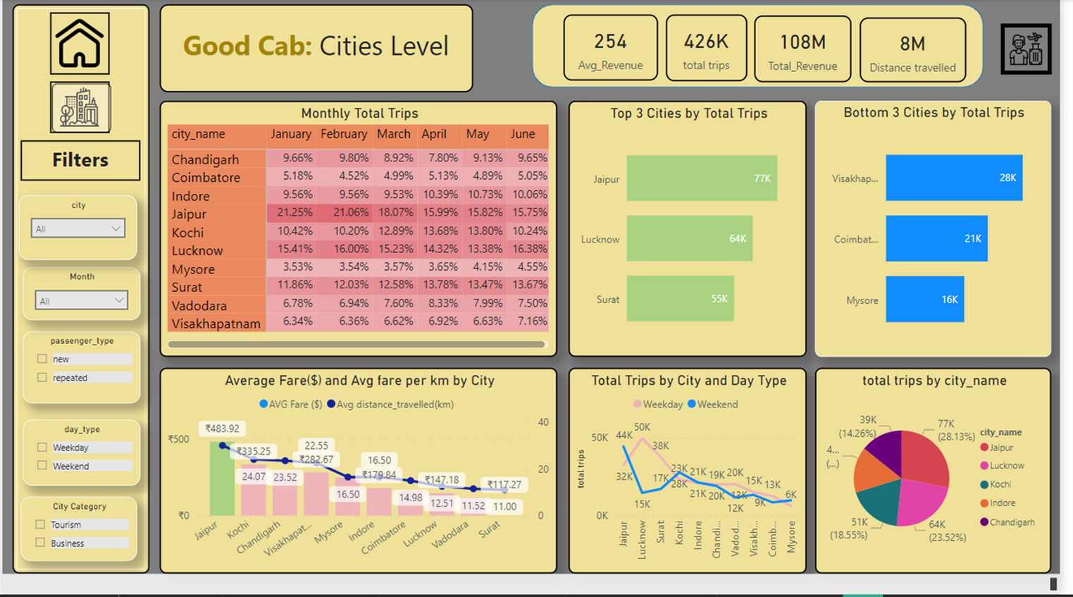
CITIES DASHBOARD

Slide 11
CITY INSIGHTS
INSIGHTS
Over the past six months, Jaipur emerged as the most travelled city, while Mysore recorded the least travel.
Lucknow led with the highest number of weekday trips (49.517), whereas Coimbatore reported the lowest number of weekend trips.
Business-centric cities like Surat, Coimbatore, and Lucknow saw a high volume of weekday trips but experienced fewer trips on weekends.

Slide 12
REPEAT PASSENGER INSIGHTS
Identify the cities with the highest and lowest repeat passenger rates.
A table was used to identify the most visited city in a month by repeat passengers.
Determine the cities that contribute the most to the highest trip frequencies among repeat passengers.

Slide 13
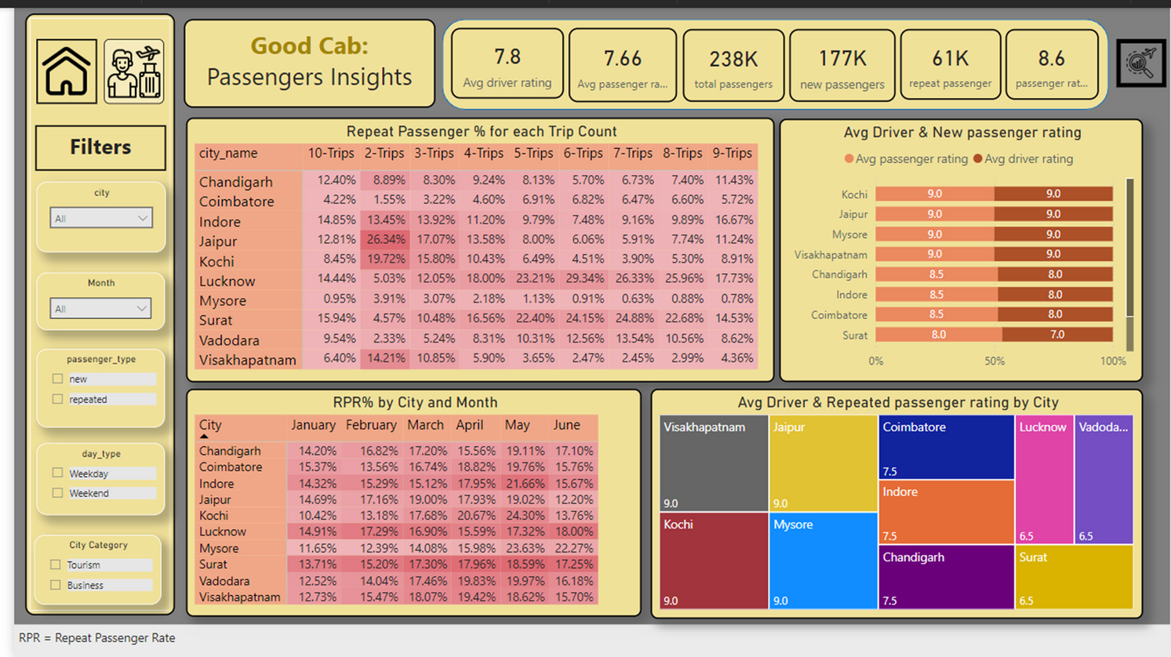
PASSENGERS DASHBOARD

Slide 14
PASSENGER INSIGHTS
INSIGHTS
Key KPIs include New and Repeat passengers.
Surat and Lucknow have the highest repeat passenger rates, while Mysore, Coimbatore, and Chandigarh report the lowest.
April and May recorded the peak repeat passenger rates.
Across all cities, 2-Trips make up the highest percentage of trips, whereas 8, 9, and 10-trips account for the lowest percentages.
Jaipur leads with the highest percentage of trips taken overall.

Slide 15
TARGET REPORT
Evaluate monthly performance by comparing total trips to target trips and new passengers to target passengers.
Analyze the average percentage rating by comparing actual passenger ratings with the target passenger ratings.

Slide 16
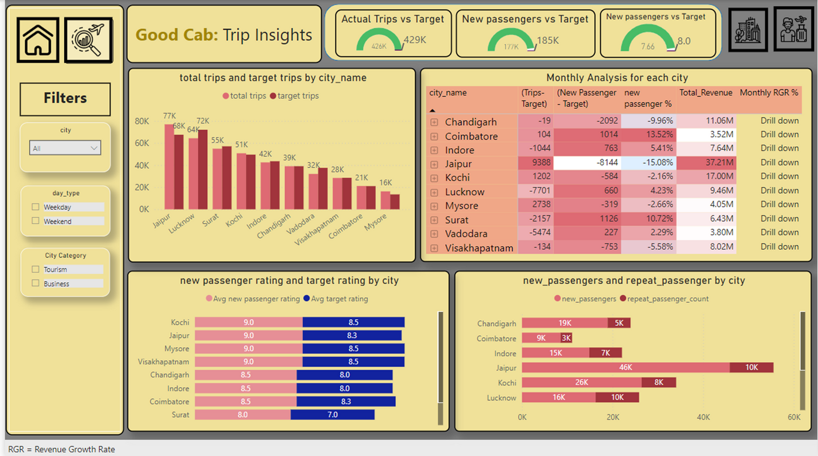
TRIP INSIGHTS

Slide 17
TRIP INSIGHTS
INSIGHTS
Key KPIs include Total Trips and Target Trips. Both January and June fell short of their targets, with June requiring an additional 11.34% trips to meet the goal— a higher shortfall than January.
April was the only month that achieved the target for new passenger arrivals, while the other months underperformed.
For passenger ratings, Mysore, Jaipur, and Kochi successfully met their targets, whereas other cities fell short.
Passenger satisfaction was notably higher in tourist cities compared to business hubs.

Slide 18
Thank you!
FOR WATCHING THE PRESENTATION

